Slide 1
CS512L
OBJECT DETECTION IN UNDERWATER SCENARIOS
Team 11
A Jyothiraditya - CS22B002
M Akash - CS22B037
M Dhanush - CS22B053
Ch Sai Madhav - CS22B060

Slide 2
AGENDA OVERVIEW
01
04
PROBLEM STATEMENT
IMPLEMENTATION
02
05
DATASET
RESULTS AND COMPARISON
03
06
PROPOSED METHOD
CONCLUSION

Slide 3
PROBLEM STATEMENT
Our study focuses on detecting and classifying objects in underwater environments using computer vision techniques.
Underwater exploration (e.g., marine life monitoring, archaeology, infrastructure inspection) needs accurate visual detection.
Challenging conditions like low visibility, light scattering, turbidity, and occlusion affect detection quality.
Boosting automation for AUVs (Autonomous Underwater Vehicles) in navigation and object interaction.

Slide 4
DATASET USED
URPC 2019
Purpose: Developed for the Underwater Robot Picking Contest to advance underwater object detection and robotic grasping capabilities.
Content: Comprises 4,757 training images and 1,029 test images, featuring five marine organism categories: echinus (sea urchin), holothurian (sea cucumber), scallop, starfish, and waterweeds.
Annotations: Provided in XML format for the training set, detailing object labels and bounding box coordinates.
Image Quality: High-resolution images up to 3840×2160 pixels, captured using underwater robots equipped with cameras.
Challenges: The dataset includes images with color deviation, blurriness, low contrast, clustered objects, and occlusion, reflecting real-world underwater conditions.

Slide 5
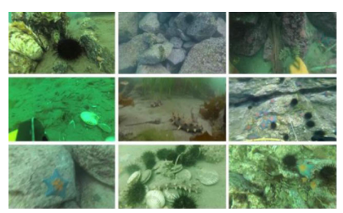
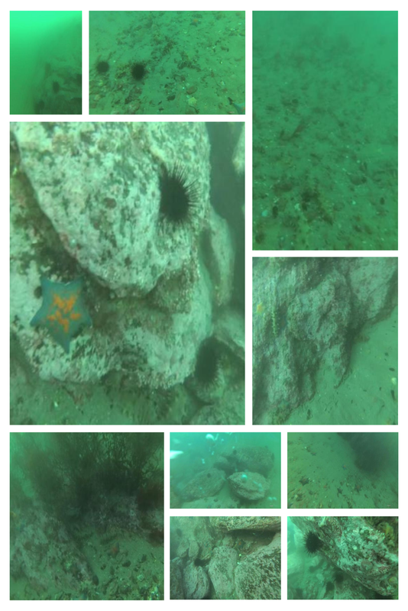
DATASET VISUALIZATION
DATASET - URPC2019
6575 images of marine life (echinus, holothurian, scallop, starfish, water weeds)
The dataset is randomly divided into training, validation, and test sets in a ratio of 7:2:1

Slide 6
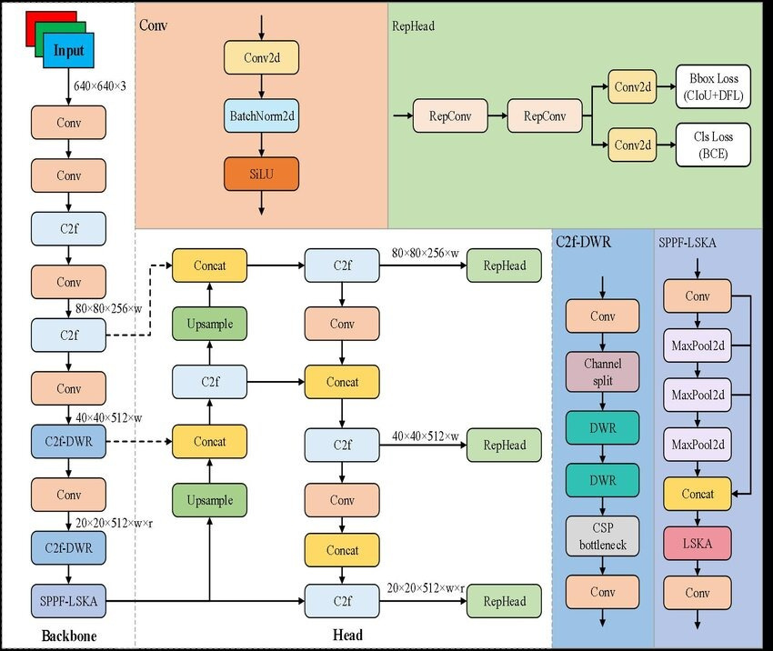
PROPOSED METHOD

Slide 7
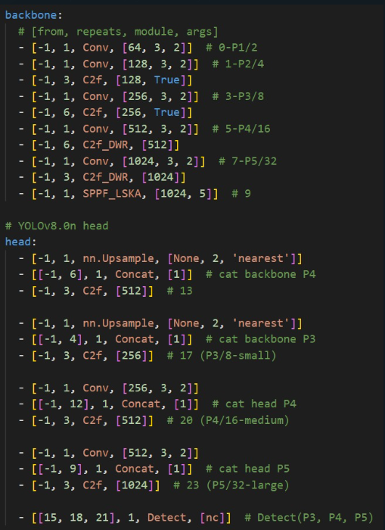
IMPLEMENTATION

Slide 8
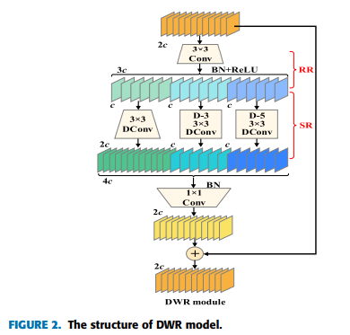
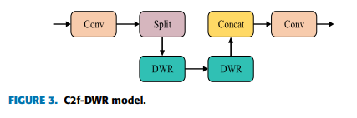
PROPOSED METHOD
C2F-DWR MODULE
Problem:
Underwater images are complicated — things look blurry, tiny, and often mix with the background.
The original C2f wasn’t good at looking at these tricky details at different scales (sizes).
Solution:
DWR helps the model see both small and large details at the same time by using different sized filters (called dilated convolutions).

Slide 9
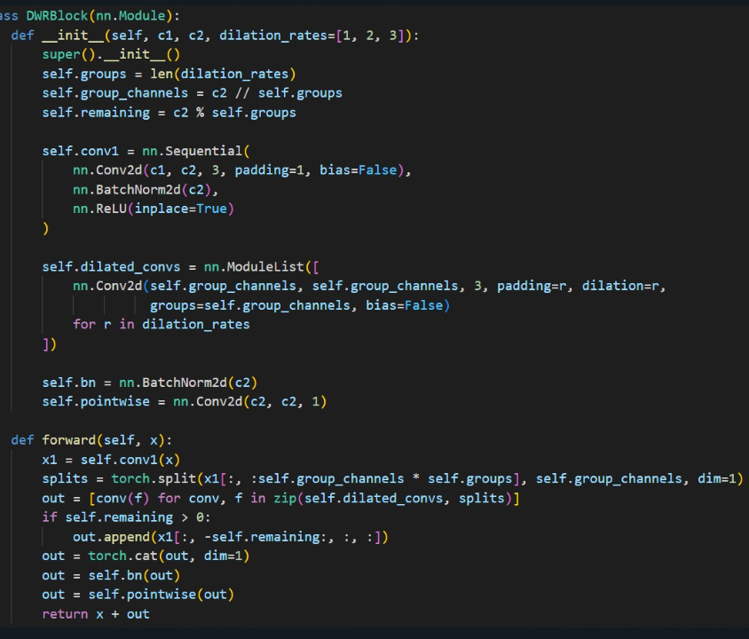
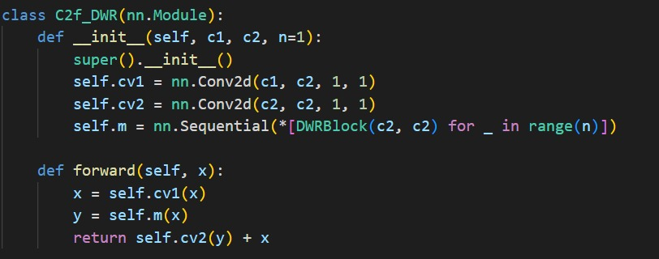
IMPLEMENTATION
DWR MODULE
C2F-DWR MODULE

Slide 10
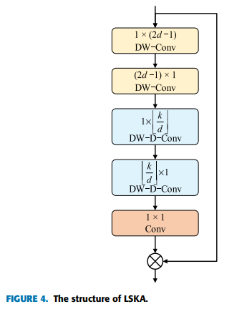
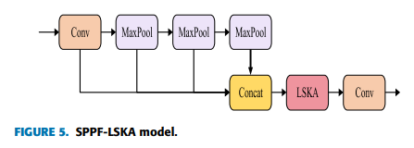
PROPOSED METHOD
SPPF-LSKA MODULE
Problem:
In YOLOv8, SPPF uses max-pooling, which only keeps the strongest signals and throws away the rest.
But in underwater images, those "weaker signals" might be important (like the edges of a seaweed or the tentacles of an octopus).
Solution:
LSKA is a smart attention module — it tells the model where to look in the image.
It looks at long-range dependencies (relationships between distant parts of the image).
It keeps more details by using smarter filtering (instead of just picking the strongest signal).

Slide 11
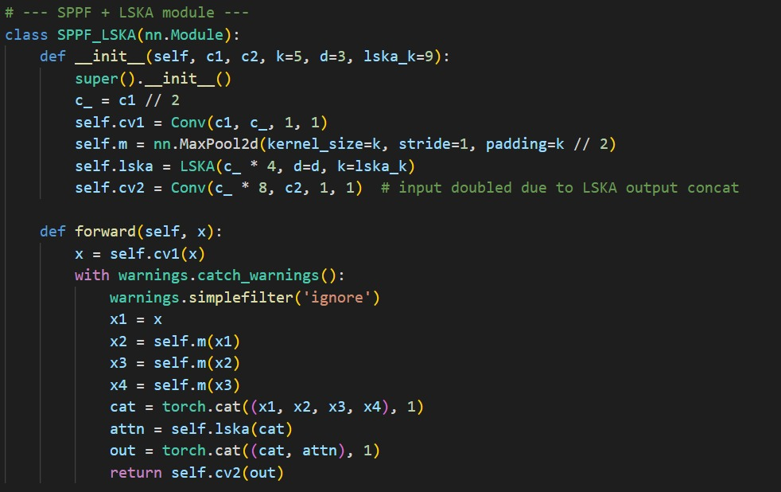
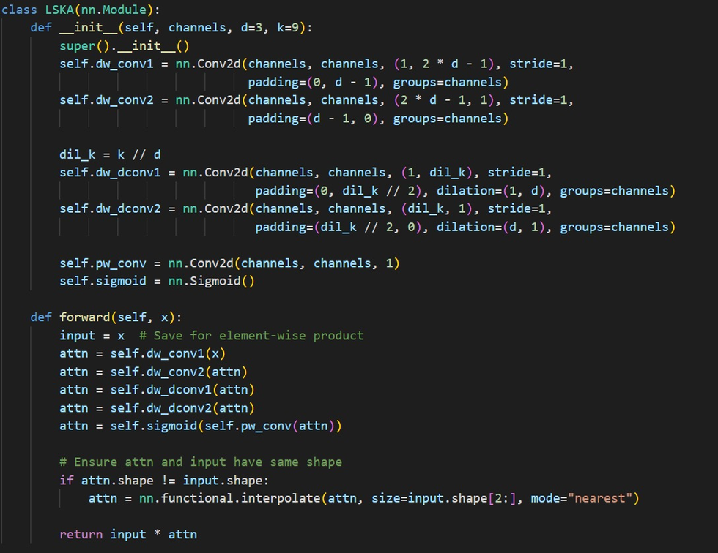
IMPLEMENTATION
SPPF-LSKA MODULE
LSKA MODULE

Slide 12
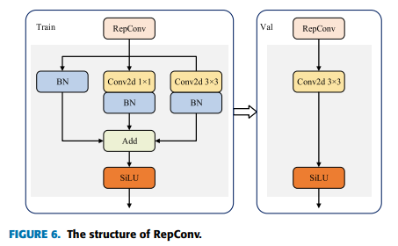
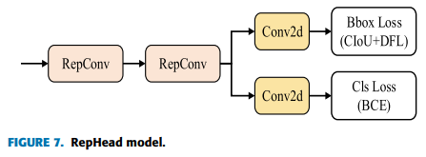
PROPOSED METHOD
REPHEAD WITH REPCONV
Problem:
The original head had two separate branches — one for finding objects and one for classifying them.
These two branches had separate weights (parameters), which makes the model bigger and slower.
Solution:
RepConv is like having multiple small paths during training (to learn better), and then merging them into one fast path during testing.
It keeps learning powerful patterns but runs faster during real-world use.
Also, the two branches now share parameters, which reduces memory and speeds up detection.

Slide 13
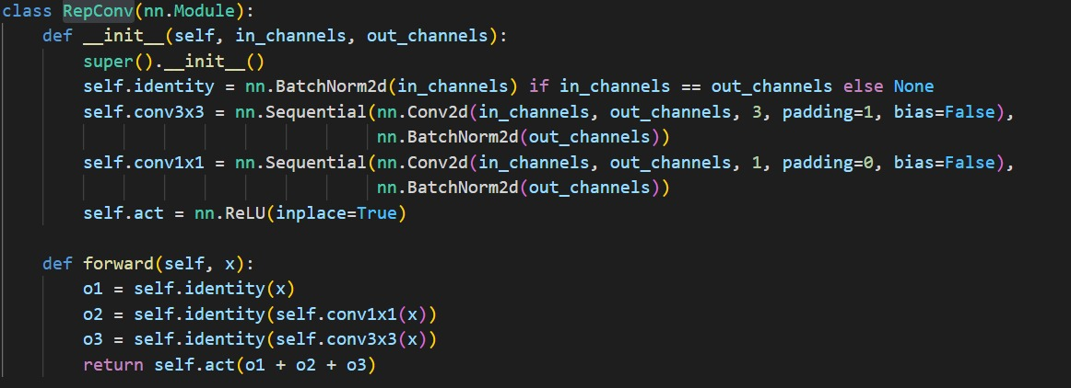
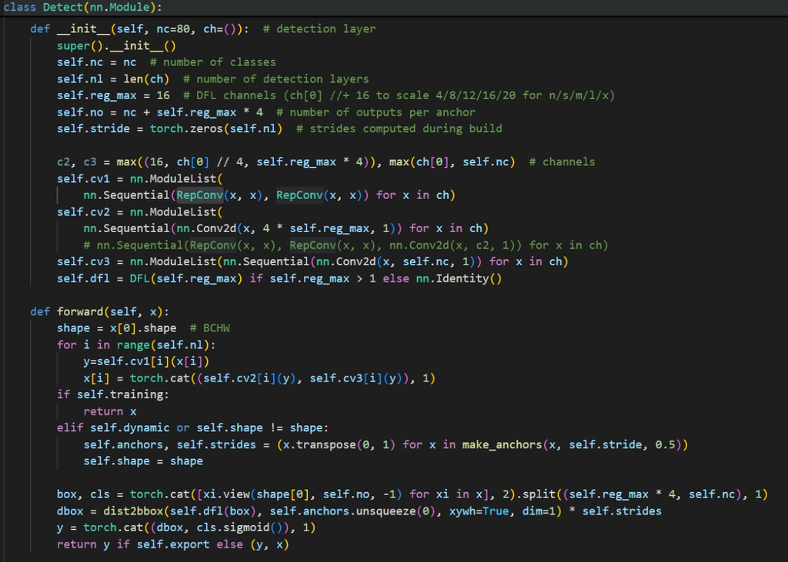
IMPLEMENTATION
REPHEAD WITH REPCONV

Slide 14
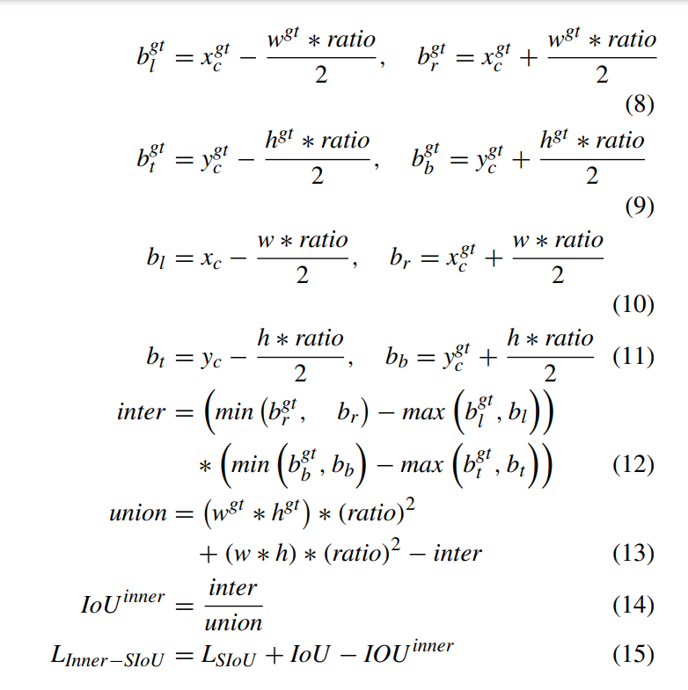
PROPOSED METHOD
INNER-SIOU LOSS FUNCTION
Problem:
Standard IoU (Intersection over Union) doesn't always give enough feedback when the box is a little off.
It doesn’t adapt well to different object sizes, especially when targets are tiny or unclear.
Solution:
It uses auxiliary (helper) bounding boxes — boxes inside the real one — to give better feedback during learning.
If the model’s prediction is close to the helper box, it gets a smaller penalty, and it learns faster.
It also adjusts the “punishment” based on object size — small objects are handled more carefully.

Slide 15
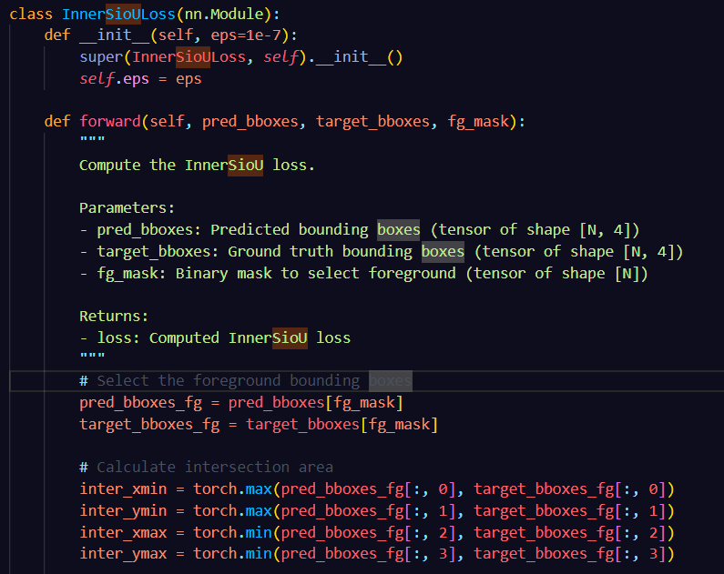
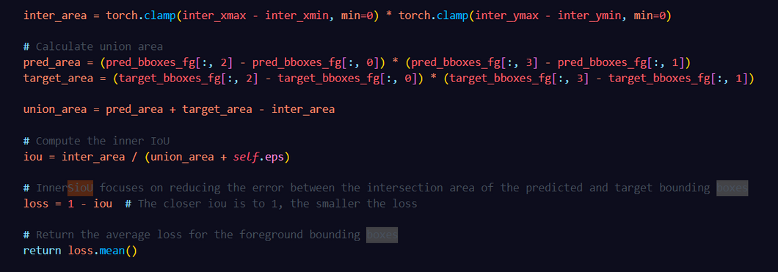
IMPLEMENTATION
INNER-SIOU LOSS FUNCTION

Slide 16
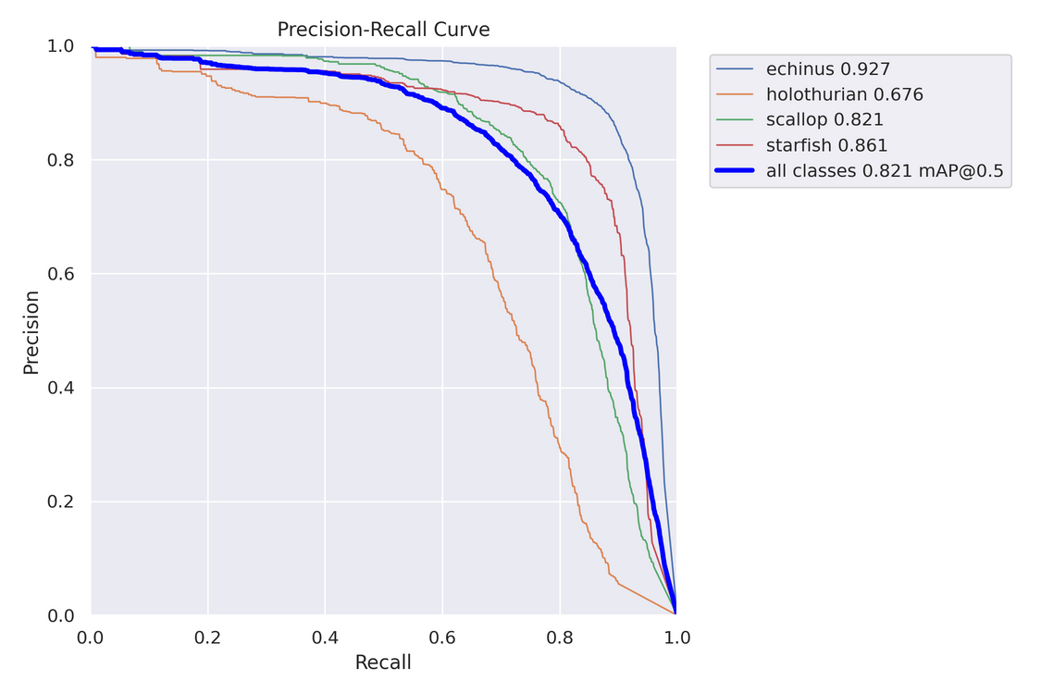
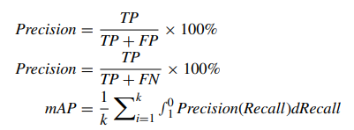
RESULTS AND METRICS
METRICS USED
Precision, Recall, mAP@0.5, mAP@0.5:0.95

Slide 17
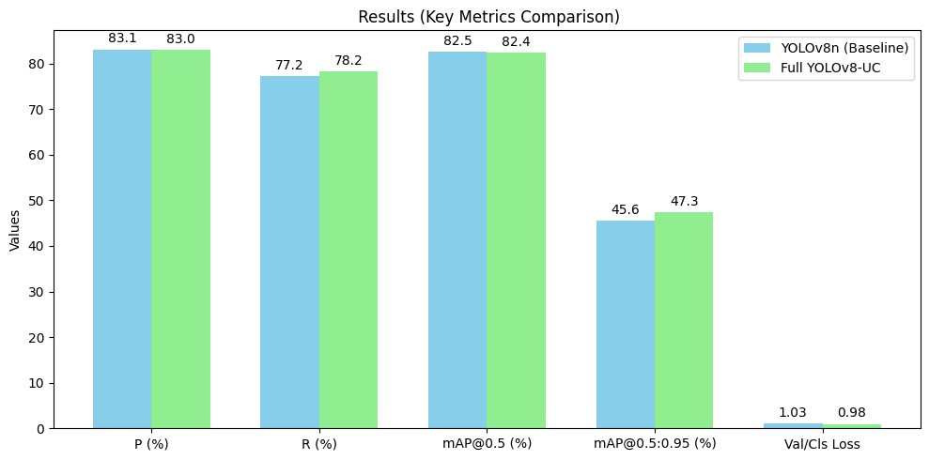
RESULTS AND METRICS
PERFORMANCE COMPARISON: YOLO AND YOLOV8_UC

Slide 18
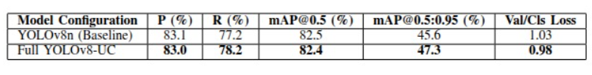
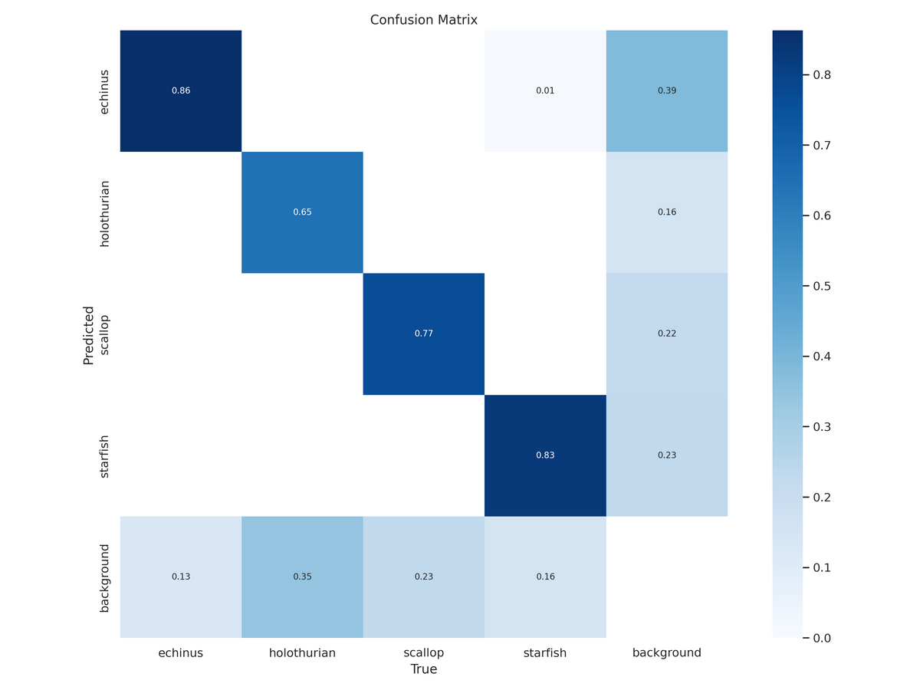
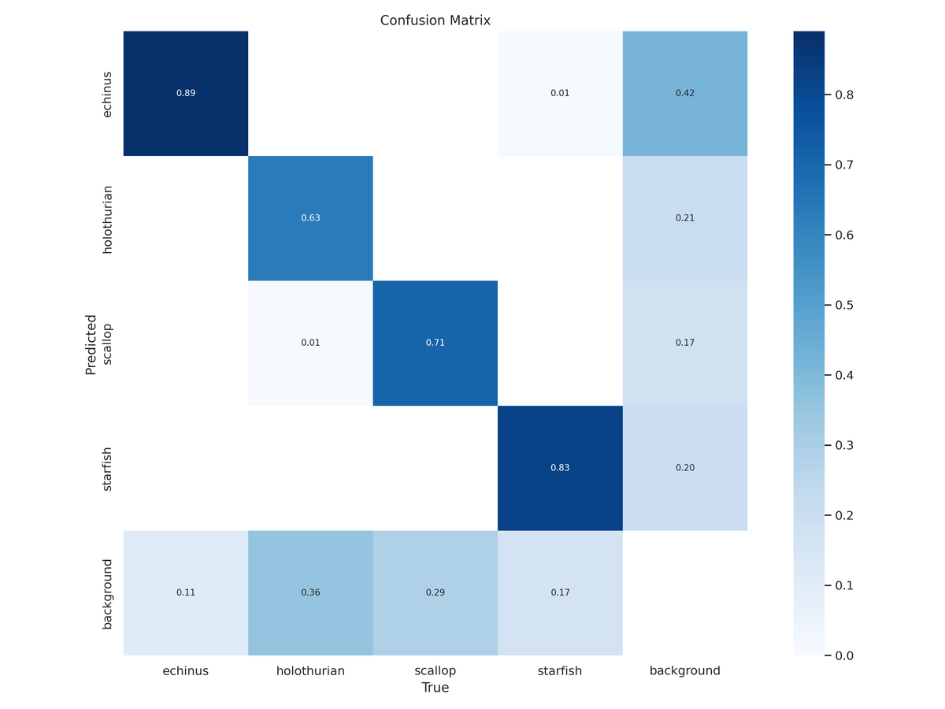
RESULTS AND METRICS
PERFORMANCE COMPARISON
YOLO_V8_UC
ORIGINAL YOLO_V8N

Slide 19
CONCLUSION
YOLOv8-UC is more suitable for underwater object detection than baseline YOLOv8n, showing both accuracy and computational efficiency improvements.
TASK DIVISION
A Jyothiraditya - Model Architecture Setup
M Akash - Training & Loss Function Integration
M Dhanush - Data Preprocessing & Dataset Handling
Ch Sai Madhav - Evaluation, Visualization & Comparison

Slide 20
THANK YOU
Team 11

